Slide 1
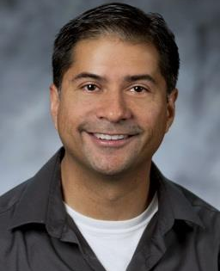
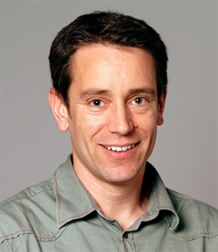
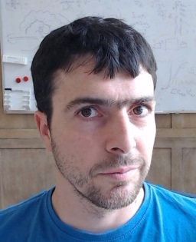
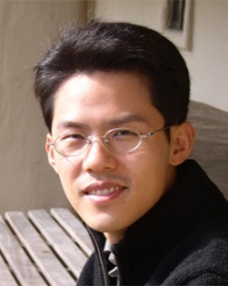
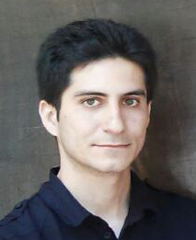
Denoising Your Monte Carlo Renders:
Recent Advances in Image-Space Adaptive Sampling and Reconstruction
Pradeep Sen
UC Santa Barbara
Matthias Zwicker
University of Bern
Fabrice Rousselle
Disney Research
Sung-Eui Yoon
KAIST
Nima Khademi Kalantari
UC Santa Barbara

Slide 2
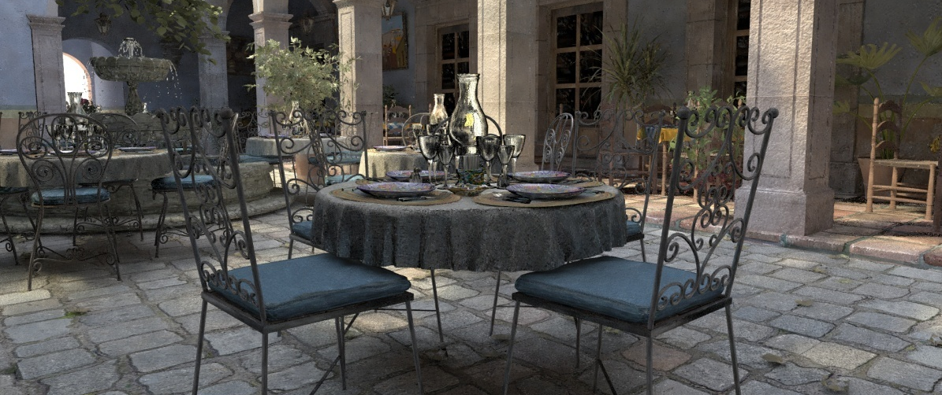

INTRODUCTION
scene by M. Leal Llaguno

Slide 3
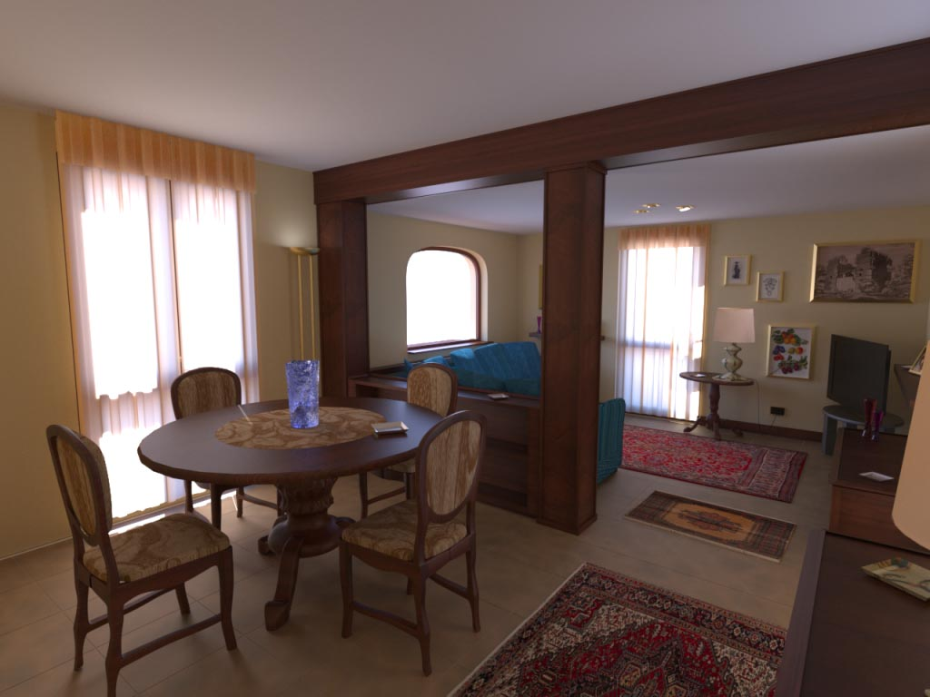
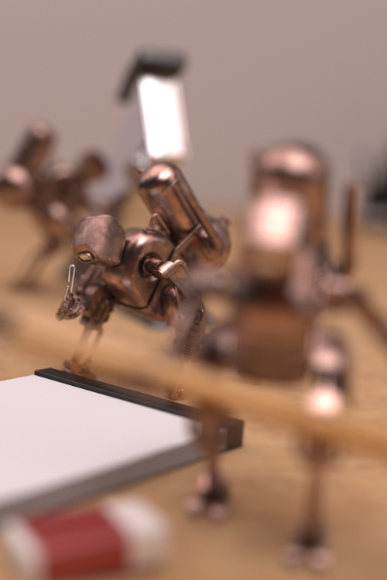
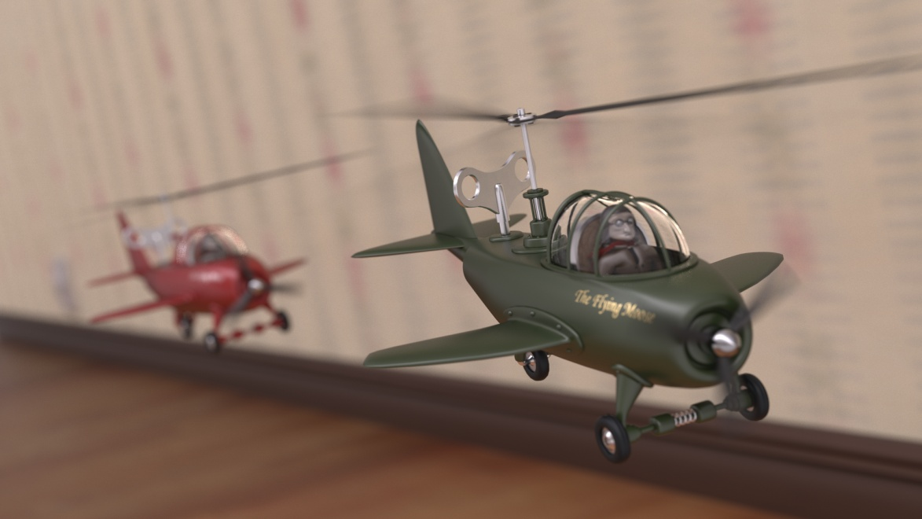
Monte Carlo rendering systems
scene by Jesper Lloyd
scene by Jesper Lloyd
scene by Luca Cugia
rendered with LuxRender
Notes:
Monte Carlo rendering systems are very powerful, and can produce visually stunning images.

Slide 4
Monte Carlo rendering systems
Advantages:
  Physically-based results
  Flexible and general (all distributed effects)
  Little user interaction required
Disadvantages:
  Potentially long rendering times
  Short rendering times produce noisy images
+
+
+
–
–

Slide 5
Monte Carlo rendering systems
Distributed Ray Tracing [Cook et al. 1984]
Render MC distributed effects (DoF, area light sources, glossy reflections, etc.)
area light
diffuse
diffuse
image
real camera
glossy
ball
Notes:
The first Monte Carlo rendering algorithm was proposed by Cook et al. in 1984.

Slide 6
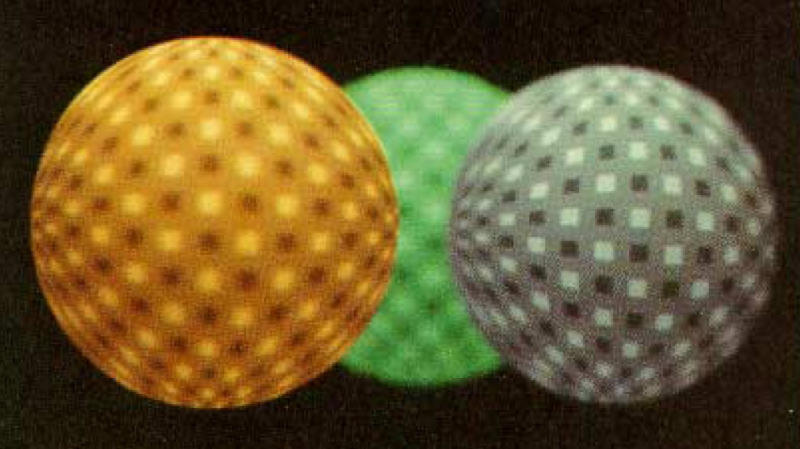
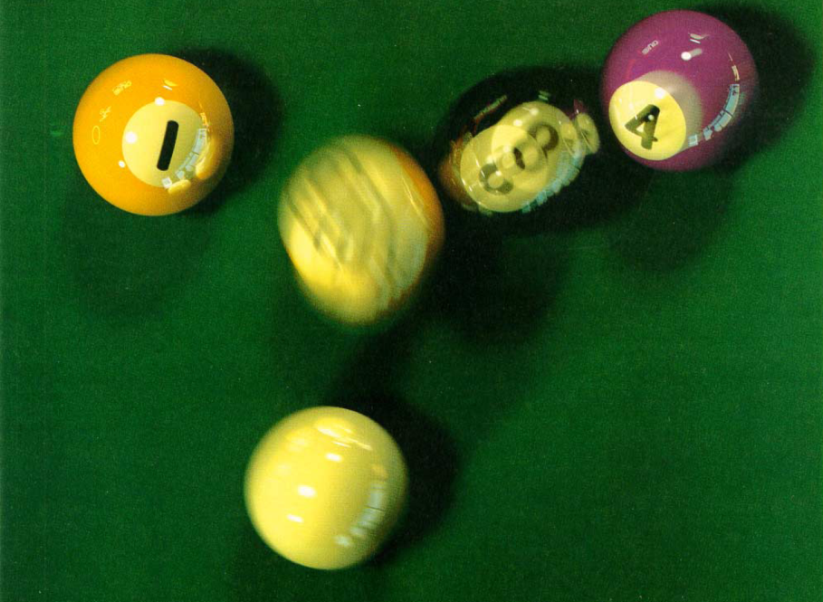
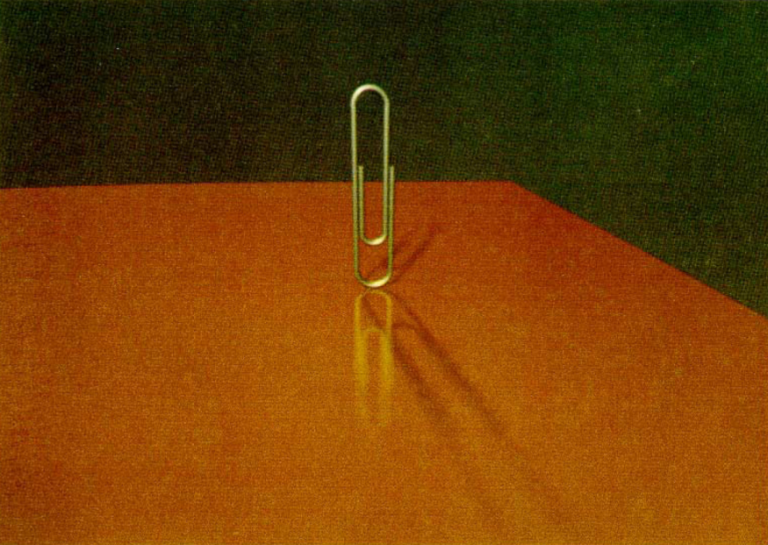
Cook et al. [1984] results
depth of field
motion blur
soft shadows
glossy reflection
Notes:
They were able to demonstrate some very impressive distributed effects.

Slide 7
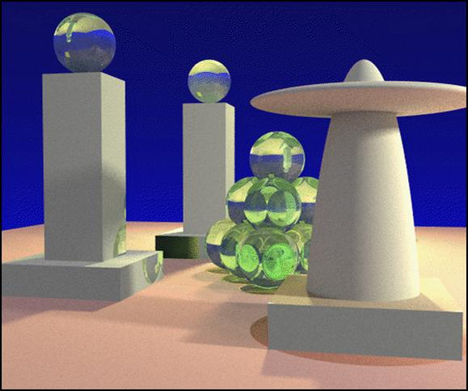
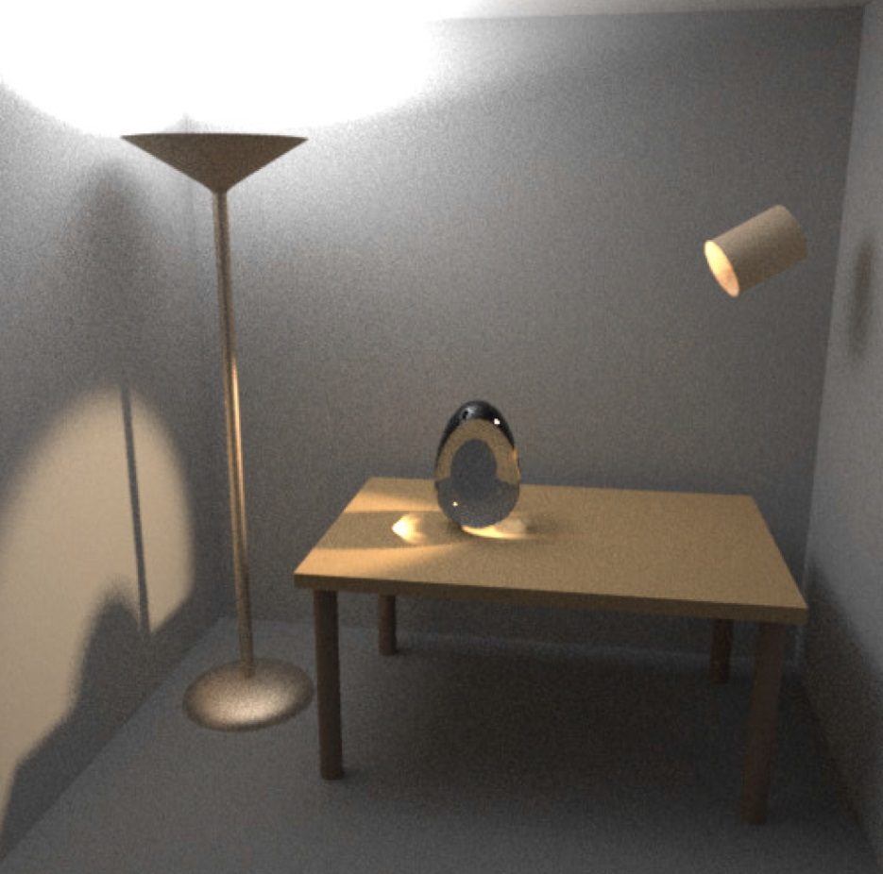
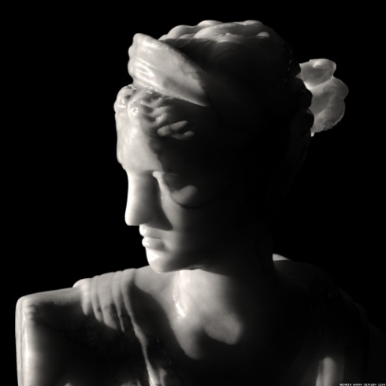
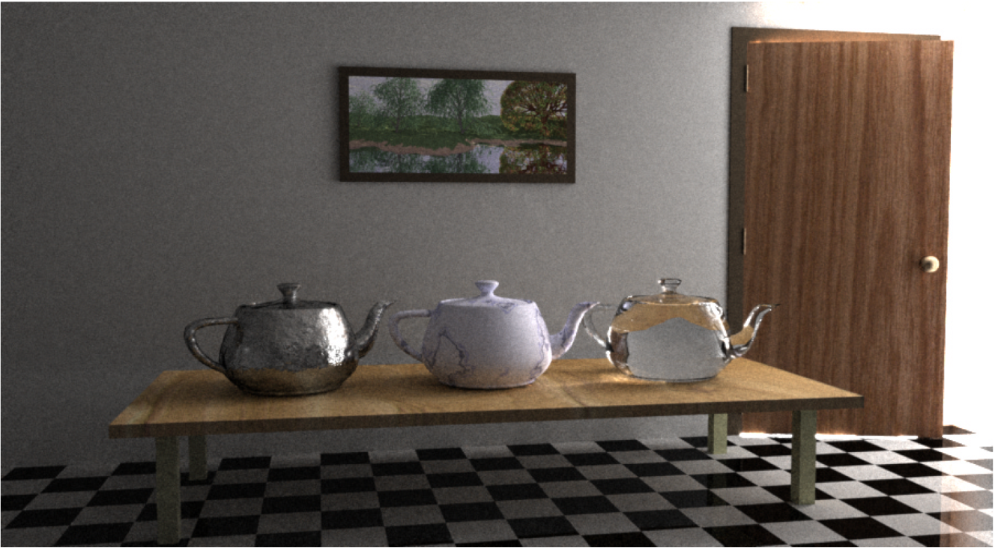
Notable Monte Carlo algorithms
Path tracing [Kajiya 1985]
Bidirectional path tracing [Lafortune & Willems 1994, Veach & Guibas 1994]
Photon mapping [Jensen 1996]
Metropolis light transport [Veach & Guibas 1997]
Notes:
There has been considerable research in Monte Carlo algorithms for rendering, some of the notable algorithms shown here. This is by no means a complete list.

Slide 8
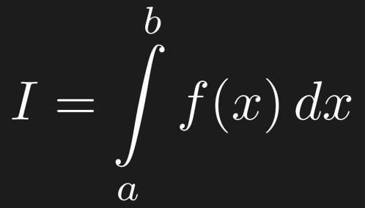
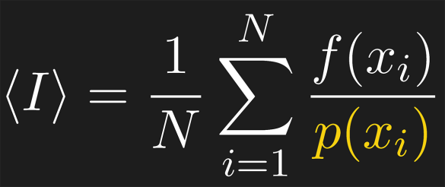
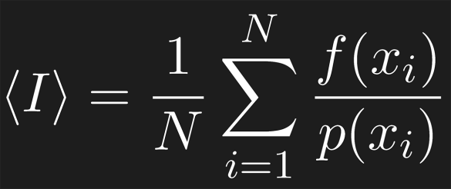
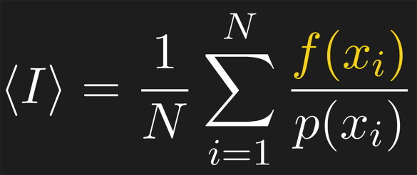
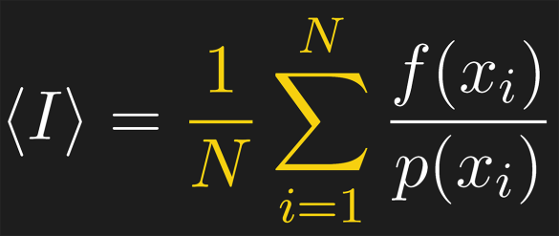
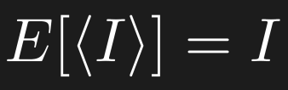
Monte Carlo integration
Given the definite integral:
We can use this estimator to compute it:
Unbiased estimator: the expected value of this estimator will be equal to the integral
Notes:
At their core, Monte Carlo algorithms use stochastic processes to calculate the integral of radiance over the different domains (over the aperture of the camera for depth of field, over the area light sources for soft shadows, over the BRDF for glossy reflections, over light paths for path tracing, etc.) We now present a basic overview of Monte Carlo integration.

Slide 9
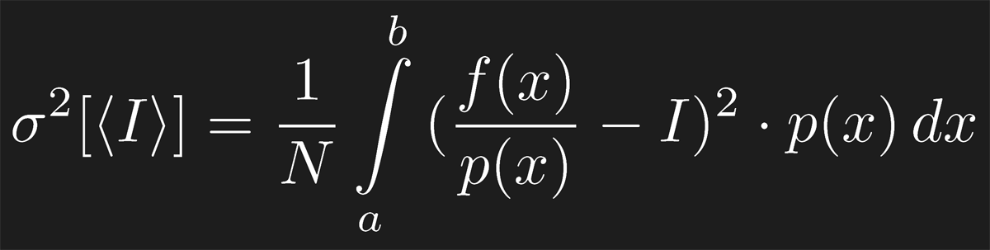

Error in our estimate
Given a number of samples, variance of the estimator will be:
Variance falls off as O(1/N)
Initial samples greatly improve estimate, later they improve it less
Huge problem for rendering…
Notes:
However, this estimator will have inaccuracies, and the variance of the estimate is given by the equation shown.

Slide 10
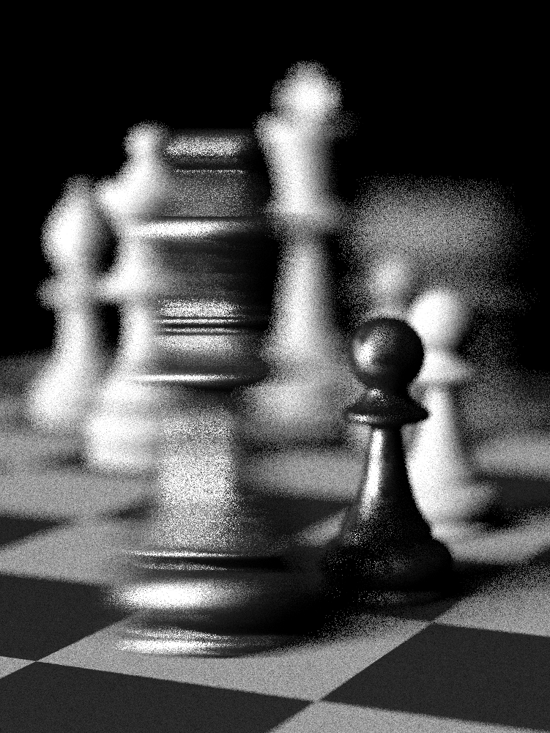
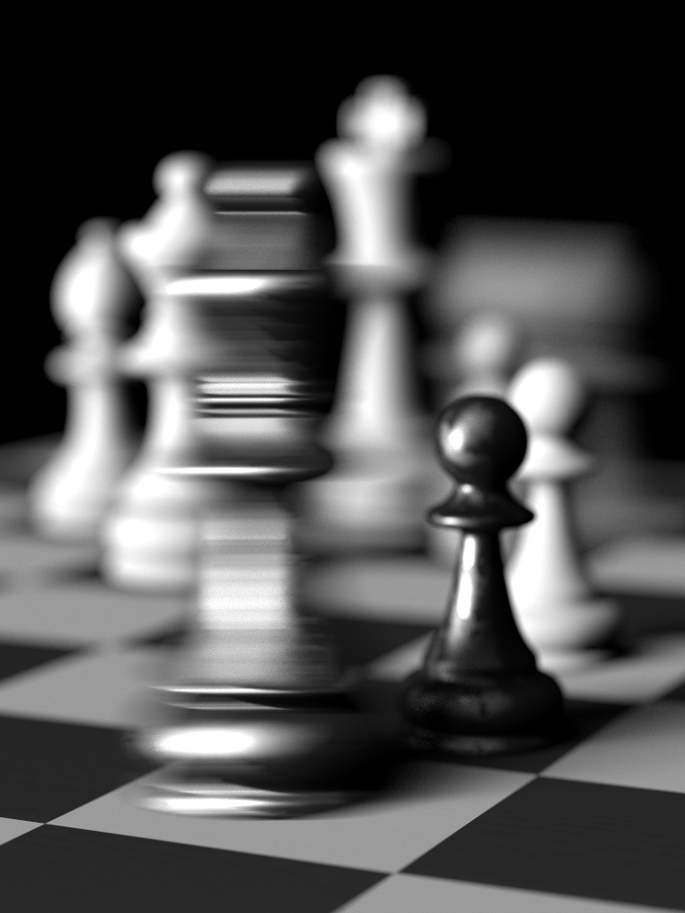
The problem
Variance appears as noise at low sample rates
16 samples/pixel
4,096 samples/pixel
scene by Wojciech Jarosz

Slide 11

The problem
More objectionable in animated sequences
scene by M. Leal Llaguno
8 samples/pixel (1.8 mins/frame)

Slide 12
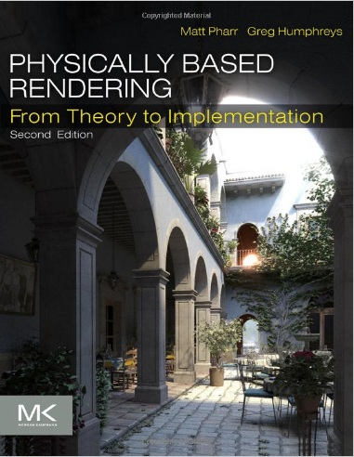
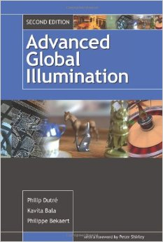
Previous work to reduce MC noise
There has been over 30 years of research to address this problem
Only provide cursory overview here, please refer to texts on the subject for more info…
Pharr and Humphreys [2010]
Dutré et al. [2010]
Notes:
There has been over 30 years of research to address the problem of Monte Carlo noise, and we can only give a very cursory overview of previous work here. We refer interested readers to texts on the subject for a more in-depth overview.

Slide 13
Tracing rays faster
Basic idea: compute samples faster so more samples can be used in estimate
Selected innovations:
  Faster intersection algorithms
    [Kay and Kajiya 1986] [Moller and Trumbore 1997] [Havel and Herout 2010]
  Ray-traversal data structures
    [Glassner 1984] [Fujimoto et al. 1986] [Arvo and Kirk 1987] [Wald and Harven 2006] [Larsson and Akenine-Moller 2003] [Gunther et al. 2007] [Popov et al. 2009]
  Memory coherent techniques
    [Pharr et al. 1997] [Wald et al. 2001, 2006] [Overbeck et al. 2008] [Garanzha and Loop 2010]
  Parallel/GPU implementations
    [Purcell et al. 2002] [Foley and Sugerman 2005] [Aila and Laine 2009] [Parker et al. 2010] [van Antwerpen 2011]
  Dedicated ray tracing hardware
    [Humphreys and Ananian 1996] [Schmittler et al. 2002,2004] [Caustic Graphics 2010] [Nah et al. 2011]

Slide 14
Better sampling techniques
Basic idea: better sampling reduces noise
Selected innovations:
  Low discrepancy / Poisson disk
    [Dippé and Wold 1985] [Cook 1986] [Ulichney 1987] [Shirley 1991] [Kopf et al. 2006] [Wei 2008, 2010] [Lagae and Dutré 2008] [Schmaltz et al. 2012] [Chen et al. 2013]
  Quasi Monte Carlo sampling patterns
    [Shirley 1991] [Keller 1996] [Keller et al. 2002]
  Importance sampling
    [Whitted 1980] [Mitchell 1987, 1996] [Veach and Guibas 1995] [Clarberg et al. 2005], [Ramamoorthi et al. 2007] [Křivánek and Colbert 2008] [Soler et al. 2009]

Slide 15
Efficient MC integration algorithms
Basic idea: reduce variance through better light path sampling
Selected innovations:
  Unbiased methods
    [Kajiya 1986] [Veach and Guibas 1994, 1997] [Lafortune and Willems 1993], [Jakob and Marschner 2012] [Lehtinen et al. 2013] [Hachisuka 2014]
  Biased methods
    [Jensen 1996, 2001] [Keller 1997] [Walter et al. 2005, 2012] [Hachisuka et al. 2008, 2009] [Jarosz et al. 2008] [Knaus and Zwicker 2011] [Hachisuka and Jensen 2011] [Georgiev et al. 2012]

Slide 16
Exploiting properties of integrand
Basic idea: integrand f( ) has properties we can exploit to place or reuse samples
Selected innovations:
  Methods exploiting anisotropy
    [Hachisuka et al. 2008] [Egan et al. 2009, 2011] [Mehta et al. 2012, 2013, 2014] [Lehtinen et al. 2011, 2012] [Munkberg et al. 2014]
  Methods exploiting transform domain
    [Chai et al. 2000] [Ramamoorthi and Hanrahan 2001] [Sloan et al. 2002, 2003], [Durand et al. 2005] [Soler et al. 2009] [Overbeck et al. 2009] [Sen and Darabi 2011] [Belcour et al. 2013]

Slide 17
Better models for specific scenes
Basic idea: efficient algorithms for specific light transport effects and materials
Selected innovations:
  Subsurface scattering
    [Jensen 2001] [Donner and Jensen 2005] [Hašan et al. 2010] [Gkioulekas et al. 2013]
  Hair rendering
    [Marschner et al. 2003] [Selle et al. 2008] [Jakob et al. 2009] [Xu et al. 2011]
  Cloth rendering
    [Zhao et al. 2011, 2012] [Irawan and Marschner 2012] [Sadeghi et al. 2013]
  Highly specular scenes
    [Jakob and Marschner 2012]

Slide 18
So why do we still need this course?
Monte Carlo rendering of complex scenes still takes many hours in production
Algorithmic improvements have been offset by increases in scene complexity
Complicates use of Monte Carlo rendering in production environments
We present approaches orthogonal to many of these previous methods
They work in screen space – independent of scene complexity
Can produce high quality results quickly…

Slide 19
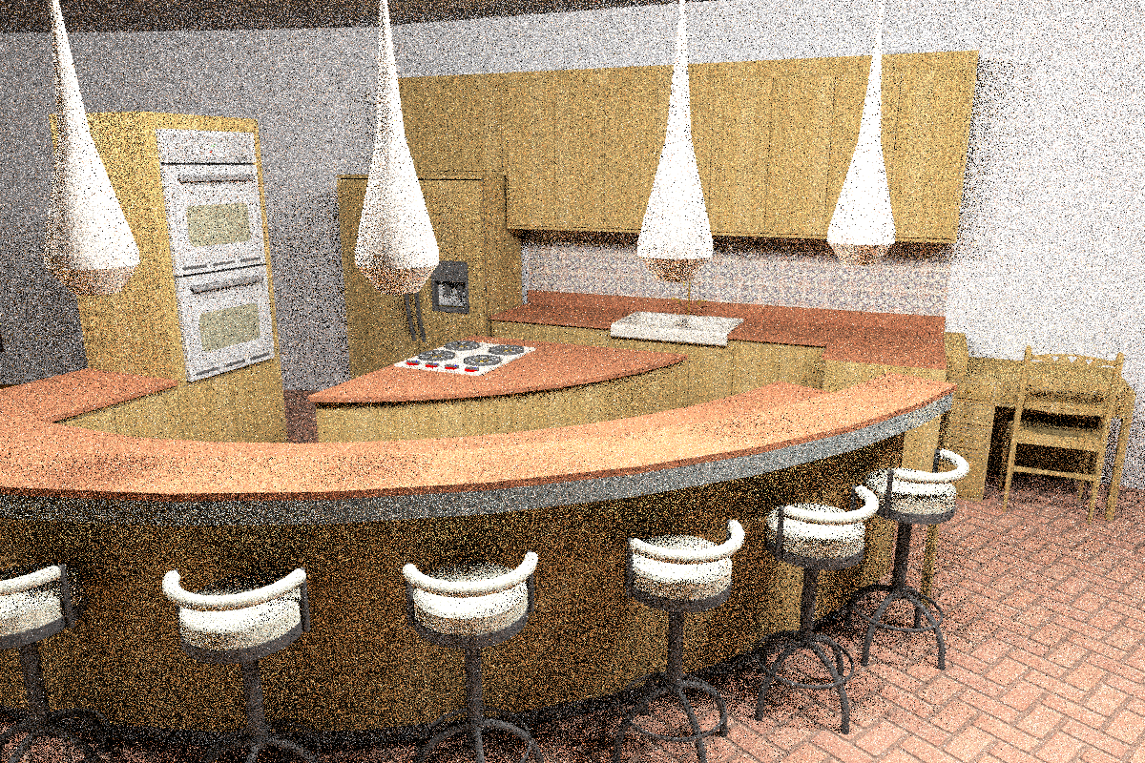
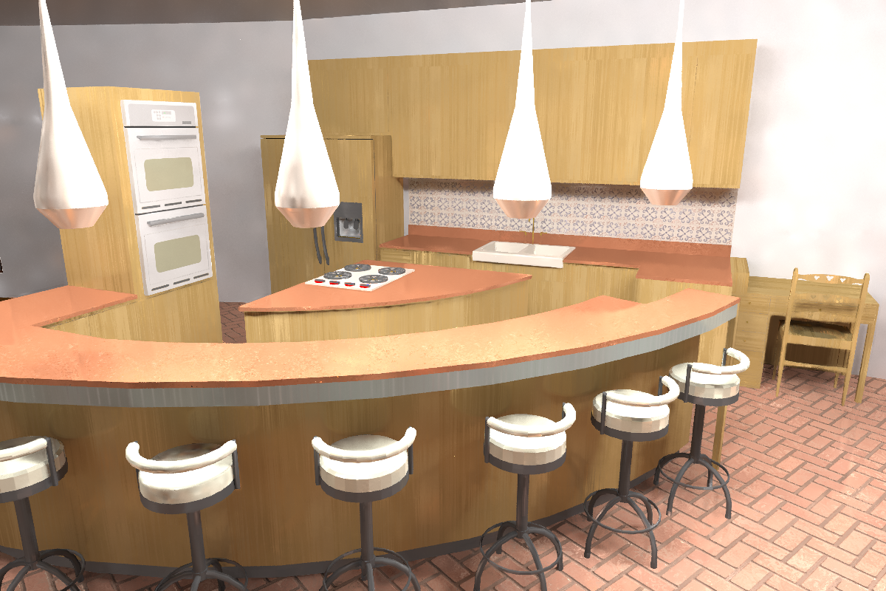
Sample result
[Kalantari et al. 2015]
Path traced scene
Filtered result
scene by Jo Ann Elliott
4 samples/pixel
(40.8 sec)
4 samples/pixel
(48.9 sec)
using only post-process filter!

Slide 20
Adaptive sampling + reconstruction
These algorithms use 2 kinds of noise reduction strategies, sometimes combined:
  Adaptive sampling algorithms
    Use information from renderer to position new samples better to reduce noise
  Reconstruction (filtering) algorithms
    Use information from renderer to remove MC noise directly
Both methods have been explored in the past!

Slide 21
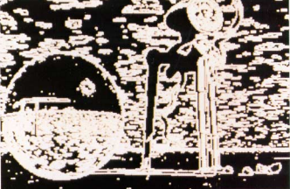
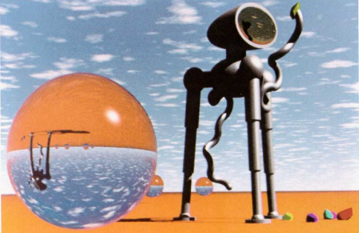
Previous work on adaptive sampling
Early on, researchers observed potential of adaptively sampling the scene
Large body of work using adaptive sampling to reduce Monte Carlo noise [Mitchell 1987, 1991] [Painter and Sloan 1989] [Bolin and Meyer 1998] [Guo 1998] [Bala et al. 2003] [Hachisuka et al. 2008] [Overbeck et al. 2009] [Soler et al. 2009] [Belcour et al. 2013]
Typically use simple reconstruction kernel (box filter or sheared filter) at the back end
These new methods combine adaptive sampling with complex image-space filters:
  Cross-bilateral
  Cross non-local means
[Mitchell 1987]
sample map
rendered image

Slide 22
Previous work on filtering
Denoising fully general MC distributed effects [Lee and Redner 1990] [Rushmeier and Ward 1994]
Denoising specific distributed effects:
  Illumination noise [Jensen & Christensen 1995] [McCool 1999] [Xu & Pattanaik 2005] [Meyer & Anderson 2006] [Segovia et al. 2006] [Laine et al. 2007] [Bauszat et al. 2011] [Egan et al. 2011]
  Depth of field or motion blur noise [Egan et al. 2009] [Soler et al. 2009] [Chen et al. 2011]
  Real-time illumination [Dammertz et al. 2010] [Mehta et al. 2012, 2013]
  Real-time depth of field or motion blur noise [Shirley et al. 2011] [Munkberg et al. 2014]
  Real-time illumination + depth of field noise [Mehta et al. 2014] [Bauszat et al. 2015]

Slide 23
New general filtering algorithms
Fully general – work for all distributed effects
Some combine adaptive sampling + filtering [Rousselle et al. 2011, 2012, 2013] [Kalantari and Sen 2013] [Moon et al. 2014]
Others are entirely post-process filters [Sen and Darabi 2011, 2012] [Kalantari and Sen 2015]
Filters using only information from renderer
Work in image space, independent of scene complexity
Biased, but produce high-quality results for offline rendering
Source code for these algorithms is available
[Mitchell 1987]
sample map
rendered image

Slide 24
Course outline
Introduction to general framework for filtering
MC denoising with general image denoising [Kalantari and Sen 2013]
Removing noise from random parameters [Sen and Darabi 2011, 2012]
Cross-bilateral and NL-means filtering with SURE-based error [Rousselle et al. 2012, 2013]
Local weighted regression [Moon et al. 2014]
Learning-based filtering [Kalantari et al. 2015]
Conclusions

